Slide 1
Normalisation
Starter: What problems might exist with this data table?
Discuss in pairs and make a list of any issues you can see.

Slide 2
Definitions
Data Redundancy: this is where data is unnecessarily repeated in a table. An example of this is data duplication.
Data Consistency: data that is repeated in a table must all be the same.
Write down these definitions

Slide 3
Definitions
0NF: A database table is said to have 0NF when its attributes contain more than one value. The data is NOT atomic. There are repeating groups of data.
Referential Integrity: This ensures that for every record in a table with a foreign key, there is a record in the corresponding table with a primary key.
Write down these definitions

Slide 4
Normalisation
Tools to reduce redundancy include use of Entity Relationship Diagrams. Another method is the use of normalisation.
What is Normalisation?
This is the process of organising the fields and tables of a database to reduce data redundancy.
For the exam you will need to understand the features of 0NF, 1NF , 2NF and 3NF.
Write down the definition above.

Slide 5
Atomic Data
Atomic Data: This is data that contains the lowest level of detail
Examples of atomic data:
An identity number
ISBN book reference e.g.1-931841-62-4
A complete description 'A fountain pen is a writing instrument'.
Examples of non-atomic data:
A full name: John Hunt when a first name and surname are also attributes in the database
Repeating groups of data are an example of non-atomic data:
Telephone is the same kind of data, repeated 3 times for the same person.

Slide 6
Un-normalised form (0NF)
ORDERS(OrderNumber, CustomerID, DeliveryAddress, EmailAddress, OrderDate, ItemCode, Description, OrderQuantity, UnitPrice)
Is this data atomic?
Unnormalised databases will have issues with inserting, deleting and updating anomalies.

Slide 7
Un-normalised form (0NF)
ORDERS(OrderNumber, CustomerID, DeliveryAddress, EmailAddress, OrderDate, ItemCode, Description, OrderQuantity, UnitPrice)
This data contains repeating groups, therefore this is 0NF.
How could we change this to make the data atomic?

Slide 8
First Normal Form (1NF)
1NF: a table is in 1NF when every data value in every field is atomic
Why is the composite key needed?
ORDERS(OrderNumber, CustomerID, DeliveryAddress, EmailAddress, OrderDate)
ORDERITEMS(OrderNumber, ItemCode, Description, OrderQuantity, UnitPrice)

Slide 9
Task: 0NF – 1NF
Complete the first tab (0NF to 1NF) in the NormalisationExercise spreadsheet.

Slide 10
Functional Dependence
Functional Dependence Definition: The value of one data field relies entirely on the value of a different data field.
Example: The field studentFirstName is entirely dependent on the field studentID

Slide 11
Second Normal Form (2NF)
2NF: a table is in 2NF when it is in 1NF and it contains no partial key dependencies.
Where is the partial key dependency below?

Slide 12
Second Normal Form (2NF)
2NF: a table is in 2NF when it is in 1NF and it contains no partial key dependencies.
Where is the partial key dependency below?

Slide 13
Second Normal Form (2NF)
2NF: a table is in 2NF when it is in 1NF and it contains no partial key dependencies.
ORDERS(OrderNumber, CustomerID, DeliveryAddress, EmailAddress, OrderDate)
ORDERITEMS(OrderNumber, ItemCode, OrderQuantity)
ITEMS(ItemCode, Description, UnitPrice)

Slide 14
Task: 1NF to 2NF
Complete the second tab (1NF to 2NF) in the NormalisationExercise spreadsheet.

Slide 15
Third Normal Form (3NF)
3NF: A table is in 3NF if it is in 2NF and it contains no non-key dependencies.
i.e. data is dependent on an attribute that is not the primary key
Where is the non-key dependency below?

Slide 16
Third Normal Form (3NF)
3NF: A table is in 3NF if it is in 2NF and it contains no non-key dependencies.
i.e. data is dependent on an attribute that is not the primary key
Where is the non-key dependency below?

Slide 17
Third Normal Form (3NF)
3NF: A table is in 3NF if it is in 2NF and it contains no non-key dependencies.
i.e. data is dependent on an attribute that is not the primary key
CUSTOMERS(CustomerId, DeliveryAddress, EmailAddress)
ORDERS(OrderNumber, CustomerID, OrderDate)
ORDERITEMS(OrderNumber, ItemCode, OrderQuantity)
ITEMS(ItemCode, Description, UnitPrice)

Slide 18
Task: 2NF to 3NF
Complete the third tab (2NF to 3NF) in the NormalisationExercise spreadsheet.

Slide 19
Plenary
Define the following from memory:
Atomic data
Functional Dependence
Un-normalised form
First Normal Form (1NF)
Second Normal Form (2NF)
Third Normal Form (3NF)

Slide 20
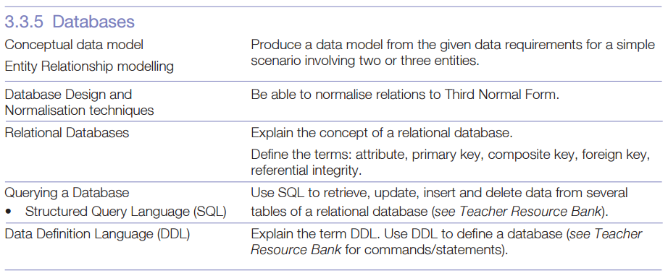
Specification Review

Slide 21
Prep: practice questions
Complete worksheet normalisation.doc, we will go over the answers next lesson.

Slide 22














Key words:
Noted clearly
Topic specific vocabulary wherever necessary
Icon for extension activity if appropriate
You might want to develop subject specific icons

